Slide 1
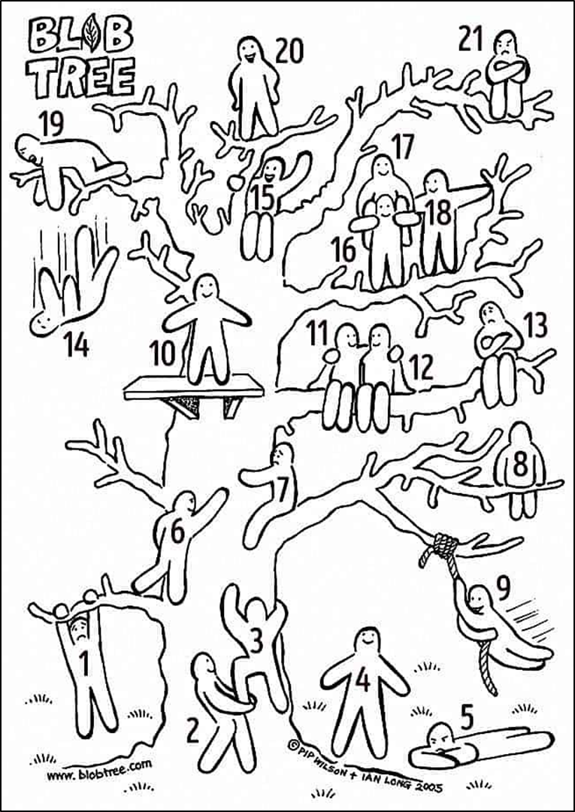

Which blob are you today and why?

Slide 2
Course content
Morality and justice
Purposes of punishment
Responses to crime
custodial sentences
non-custodial sentences
capital punishment
Todays lesson
The 4 purposes of punishment are?

Slide 3
The 4 purposes of punishment are?
Deterrence - punishment should put people off committing crime.
Protection - punishment should protect society from the criminal and the criminal from themselves.
Reformation - punishment should change the criminal.
Retribution - punishment should make the criminal pay for what they have done wrong.

Slide 4
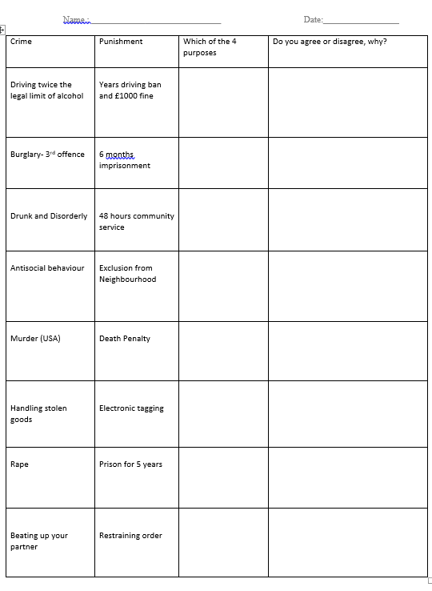

Starter task: Complete this worksheet.
Think carefully about your opinion about these forms of punishment.

Slide 5


Slide 6

Would you rather ?

Slide 7

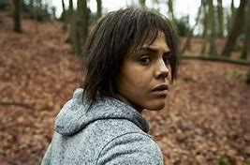
Homework
Watch: Black Mirror: Series 2 episode two “White Bear.”
No spoilers if you’ve already seen it! You can find it on youtube.
Be ready to talk about it next Tuesday.
It might be worth taking notes or watching it a couple of times. Focus on this question “ What is the form of punishment being used and do you think it is morally acceptable?”

Slide 8
Course content
Morality and justice
Purposes of punishment
Deterrence
Protections
Reform
Retribution
Responses to crime
custodial sentences
non-custodial sentences
capital punishment
Todays lesson

Slide 9
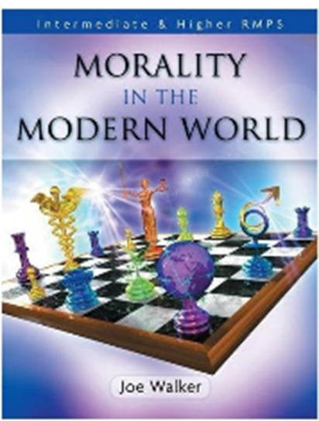
Using the text books “Morality in the modern world” page 87 onwards we are going to create some detailed notes.
For each punishment we are going to write down:
A definition
Two strengths.
Two weaknesses.
Three Moral issues.
A religious response to this.
Your view on this issue.
A non religious response to this.

Slide 10
Deterrence. Pages 96- 99
Protection. Pages 101-103

Slide 11
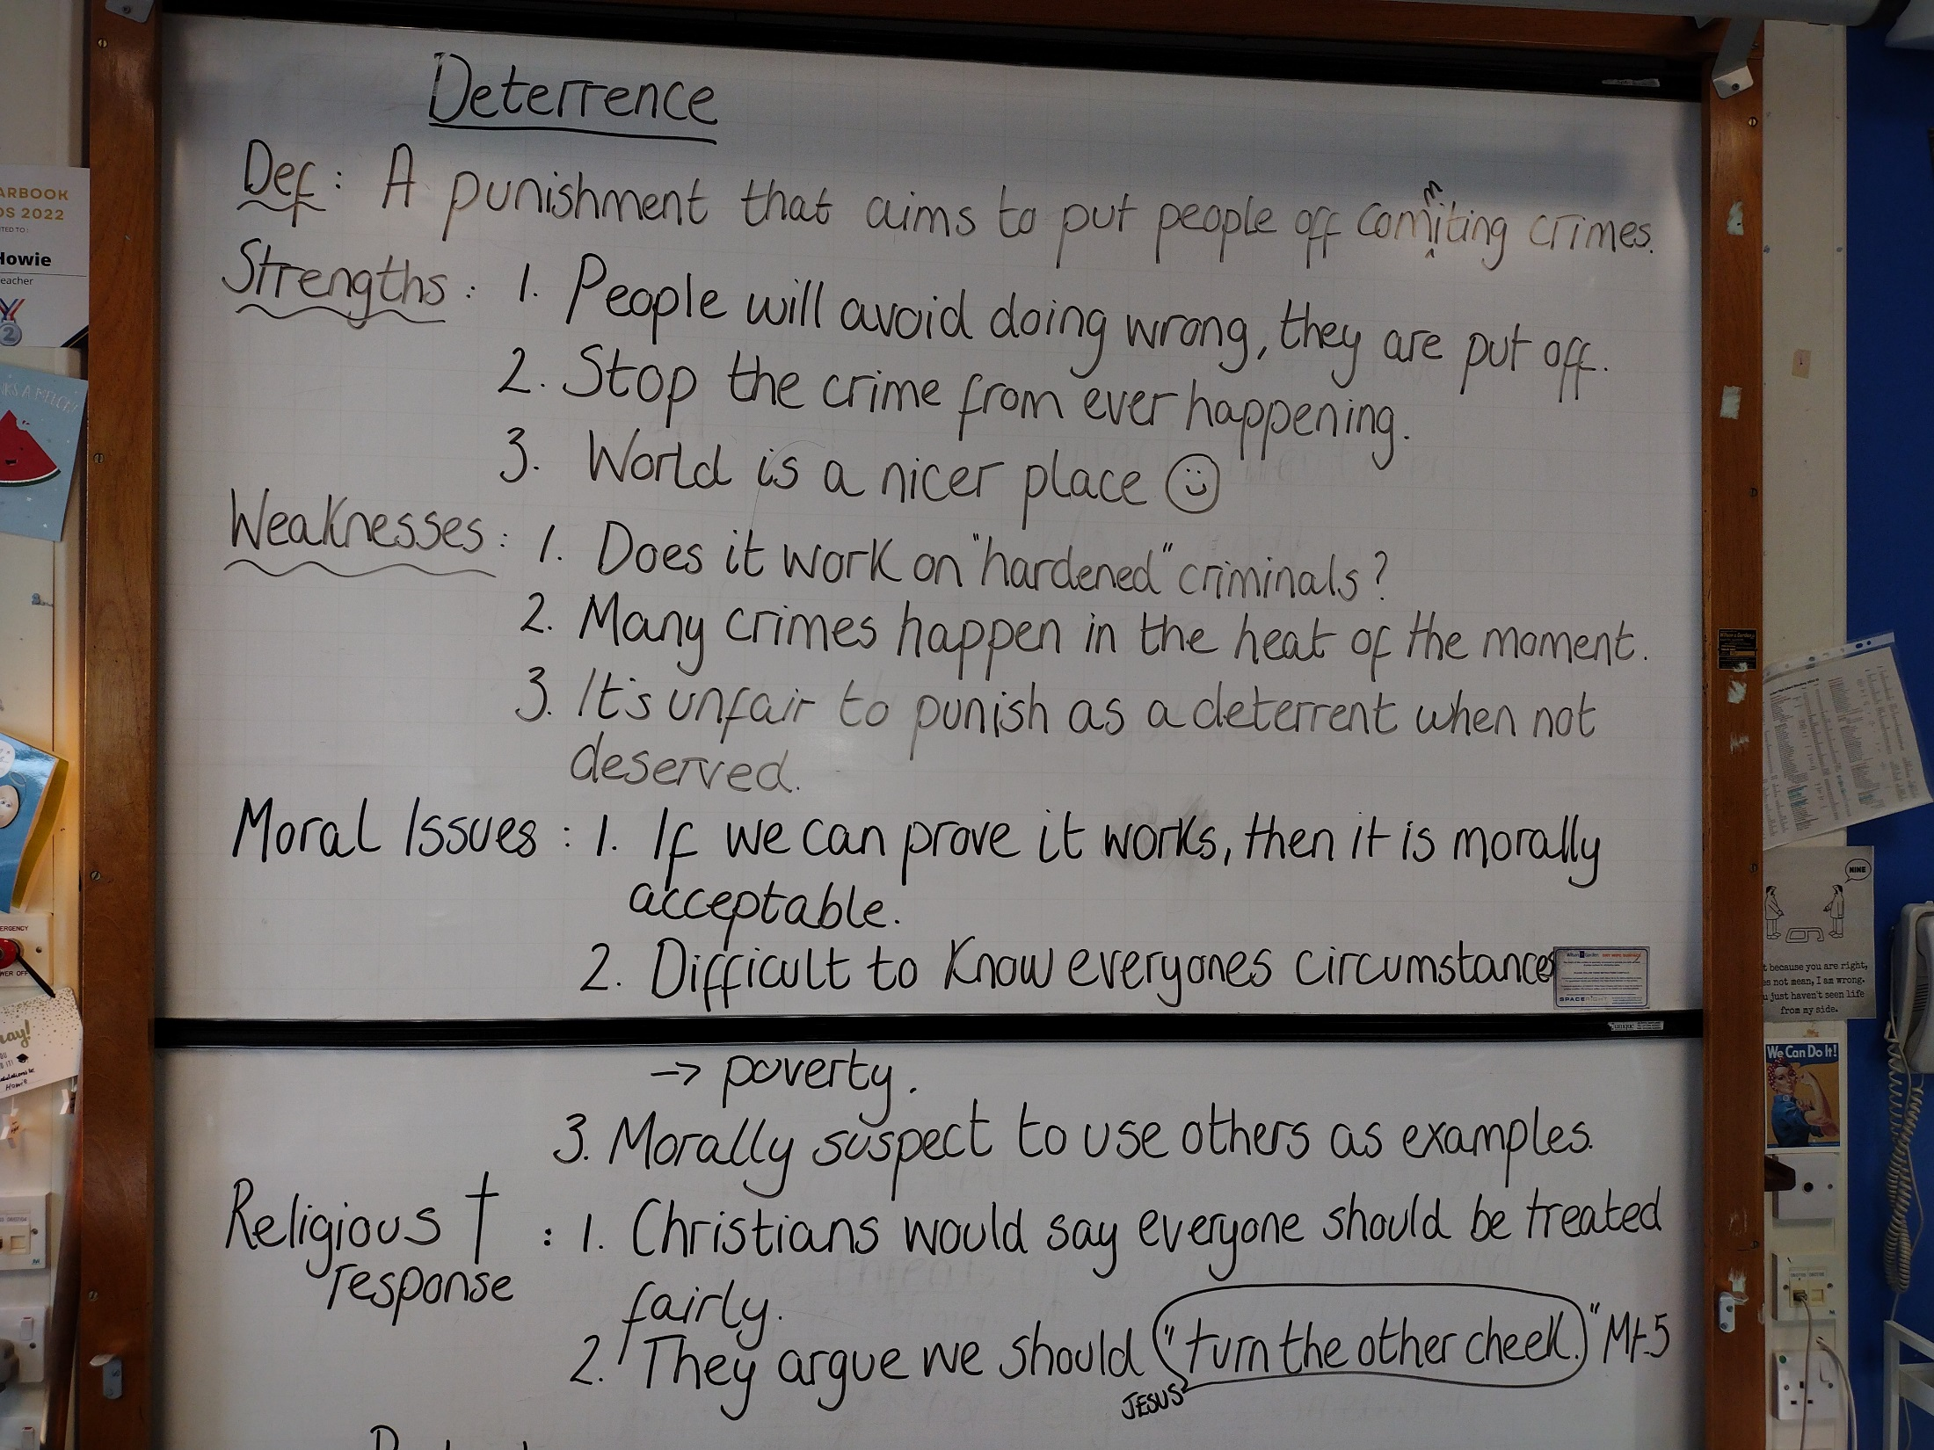

Slide 12
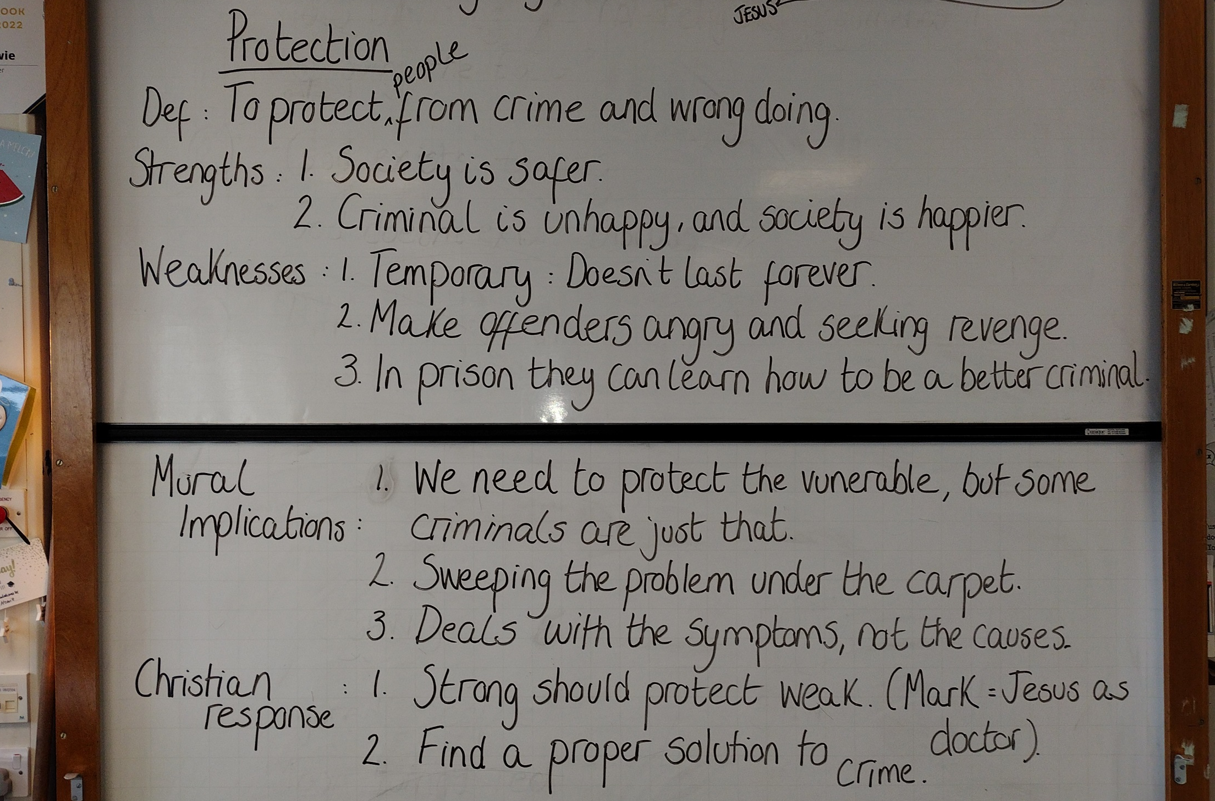

Slide 13

Task:
Lets discuss Black Mirror: Episode two “White Bear.” What did you think?
Written task:
In Black mirror and the episode White Bear we see a new form of punishment being used by the UK legal system. This involves a form of retribution for a convicted child murderer.
The interesting thing was …..

Slide 14
Reformation. Pages 104- 106
Have you ever changed your ways?

Slide 15
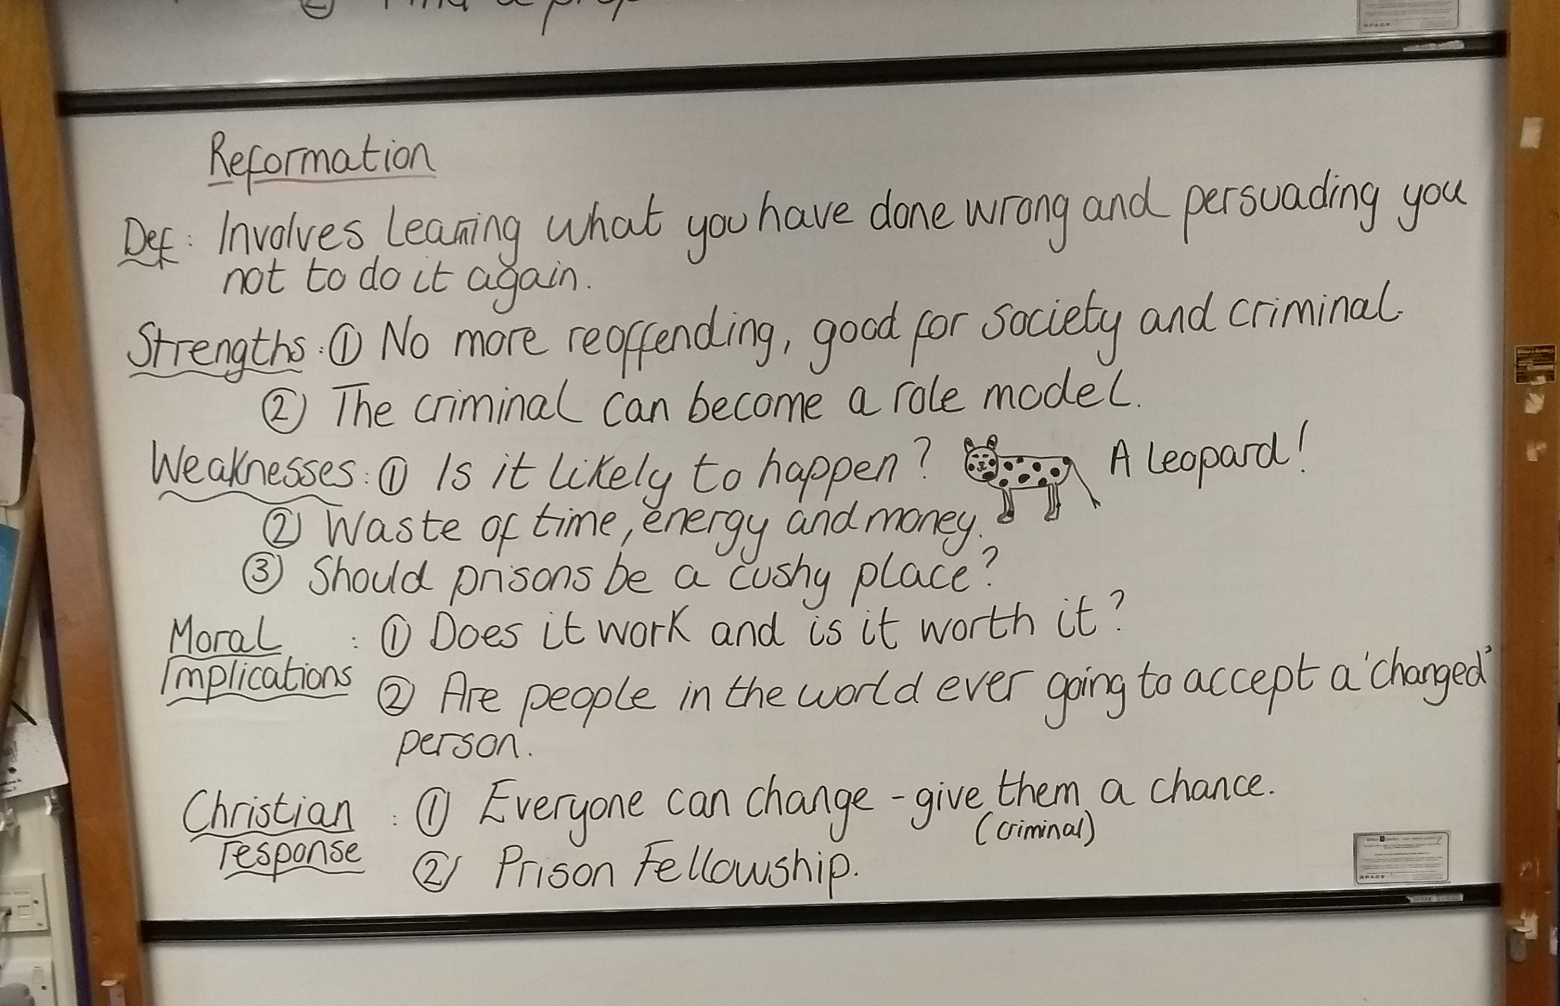

Slide 16
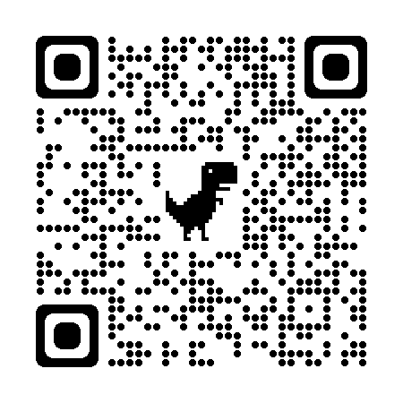
Reformation. Pages 104- 106
https://prisonfellowship.org.uk/
https://www.youtube.com/watch?v=5kO55QqKy4s

Slide 17
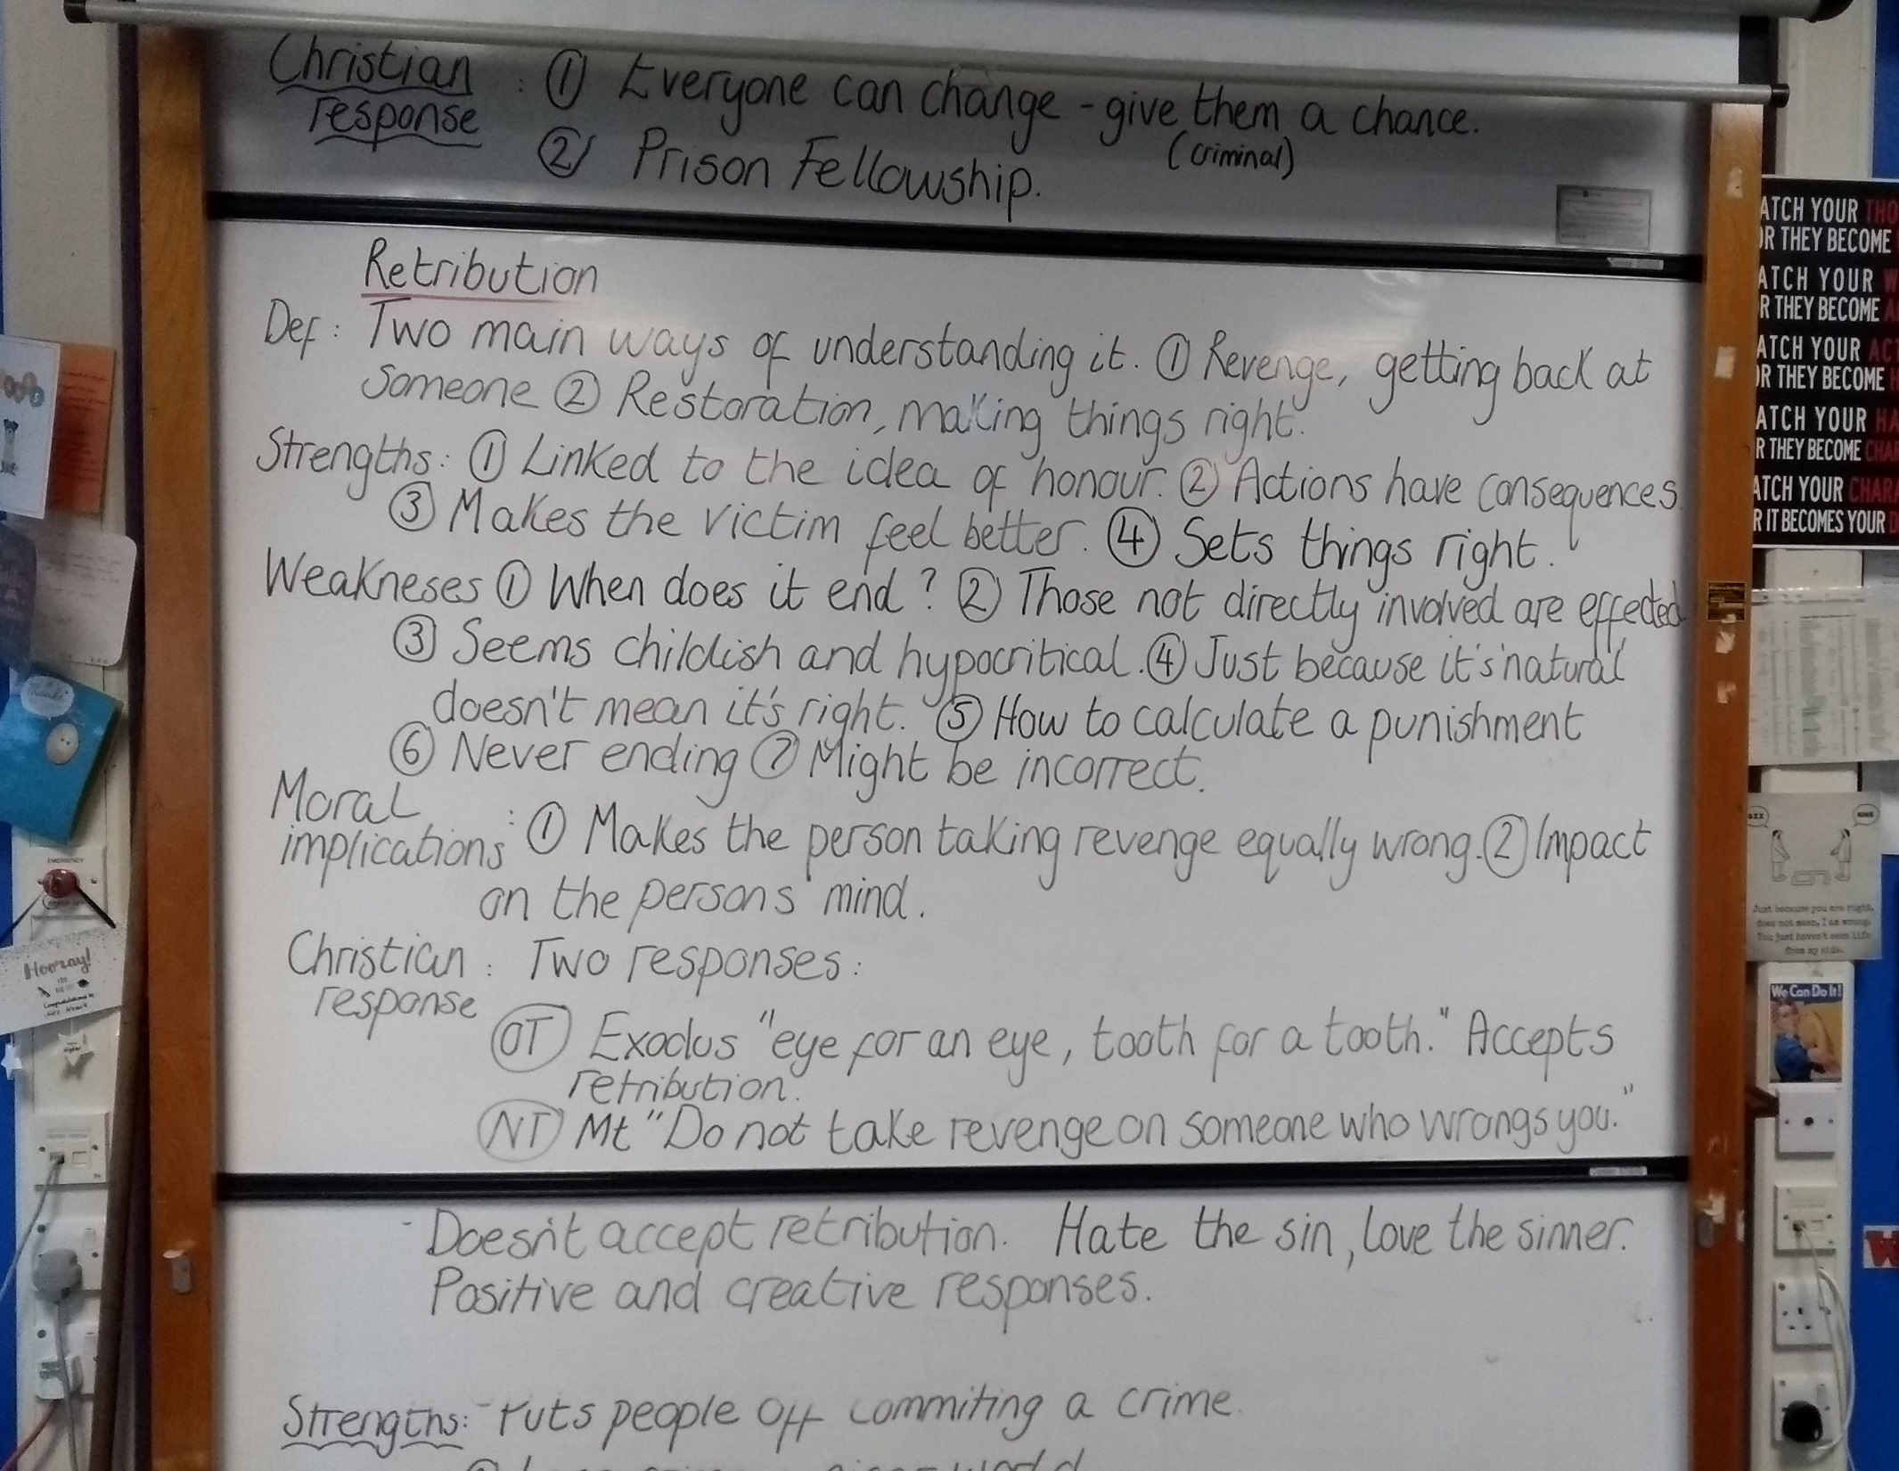

Slide 18
Retribution. Pages 87-92
https://www.youtube.com/watch?v=WDiT2Vr-wjA Rabbi sacks !

Slide 19

Time for your own opinion.
For each purpose of punishment consider your opinion on it.
Perhaps it would help to imagine you had been a victim of a crime.
How would you want the criminal to be punished?
Does it make any difference what the crime was?
How about who the criminal was? Or what their motives were, does that change anything?
Do you think you are capable of making a fair judgement?
What about some of the moral issues each punishment presents. Do they connect with your opinion/ Why, in what way?

Slide 20
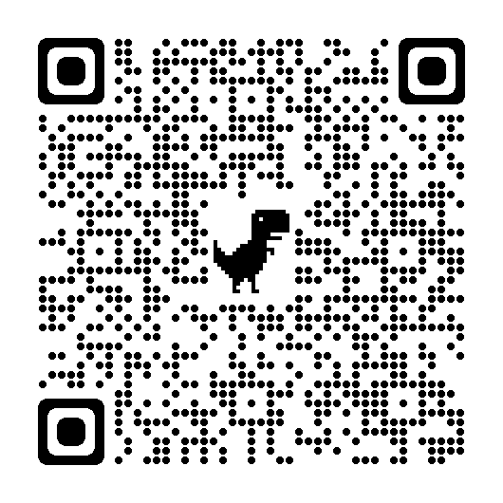
Retribution. Pages 87-92
https://www.youtube.com/watch?v=WDiT2Vr-wjA Rabbi sacks !
Truth and reconciliation: Mandela.
Find out about it and write a few key facts down.
http://news.bbc.co.uk/1/hi/special_report/1998/10/98/truth_and_reconciliation/203134.stm
https://www.youtube.com/watch?v=yjYm78K6aNI

